Slide 1
Agentic Career Counseling Companion
CAPSTONE PROJECT
Student Name: NIKHIL SHAM SALUNKE
College Name: KLS VISHWANATHRAO DESHPANDE INSTITUTE OF TECHNOLOGY,HALIYAL,KARNATAKA.
Department :CSE(AIML)

Slide 2
OUTLINE
Problem Statement
Technology used
Wow factor
End users
Result
Conclusion
Future scope
IBM-Cerifications
Git-Hub Link

Slide 3
Problem Statement
Students often struggle to make informed career decisions due to fragmented access to guidance, limited self-awareness of academic strengths, and rapidly evolving industry landscapes.
Traditional counseling methods lack personalization and scalability, leading to missed opportunities and career mismatches.
The challenge is to develop an intelligent, autonomous agent that continuously monitors student performance, evolving interests, and real-time labor market trends to deliver tailored career pathway suggestions. This would empower students to make confident, future-ready decisions with minimal dependency on manual intervention.

Slide 4
Technology used
IBM cloud lite services
Large Language Model (LLM)
IBM Granite model
Data Feeds (for dynamic responses)
Custom Tools
Knowledge Uploads

Slide 5
IBM cloud services used
IBM Cloud Watsonx AI Studio
IBM Cloud Watsonx AI runtime
IBM Granite foundation model
Granite-3-3-8b-instruct
llama-3-3-70b-instruct

Slide 6
Wow factors
The Agentic Career Counseling Companion is designed to dramatically reduce the time and confusion students face when exploring career paths.
It empowers them to make confident, future-ready decisions by aligning their academic strengths, personal interests, and real-time job market trends.
This intelligent agent continuously monitors student performance and evolving goals, offering dynamic and personalized career suggestions.
Key features include real-time labor market integration, interest-to-career mapping, skill gap analysis, and targeted learning recommendations.
The agent also supports autonomous, natural conversations, enabling students to receive guidance without manual intervention.
By providing 24/7 access to tailored advice, it scales the impact of career counseling while fostering self-awareness, long-term planning, and alignment with emerging opportunities.

Slide 7
End users
Students
Educators And Counsellors
Institutional End Users
Corporate & Workforce Development

Slide 8
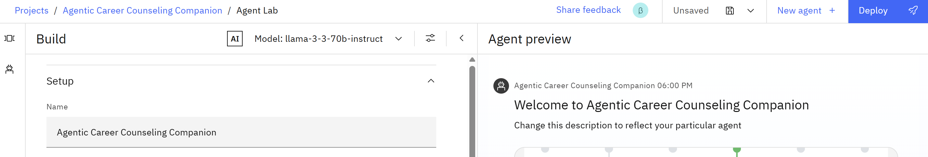
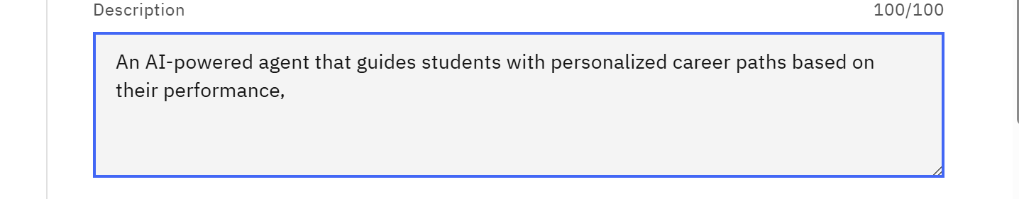
Process

Slide 9
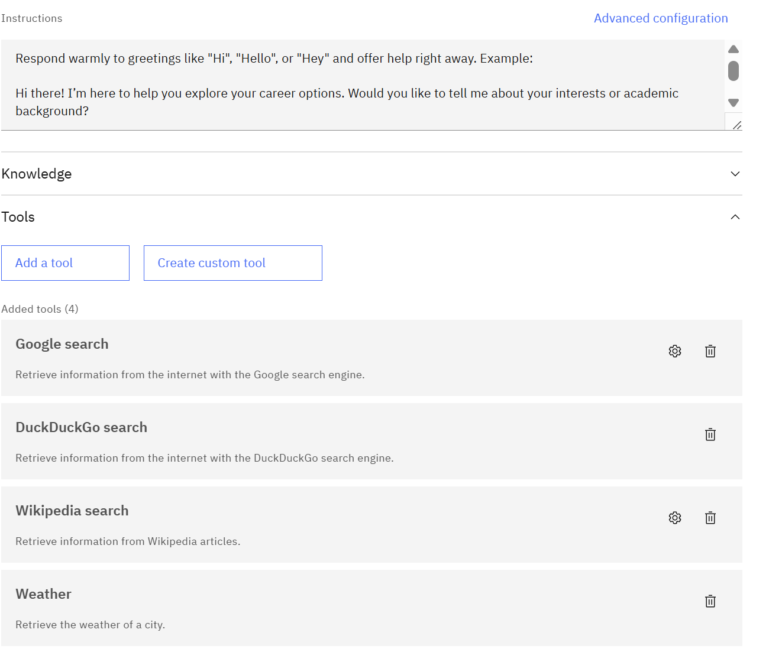
Process

Slide 10
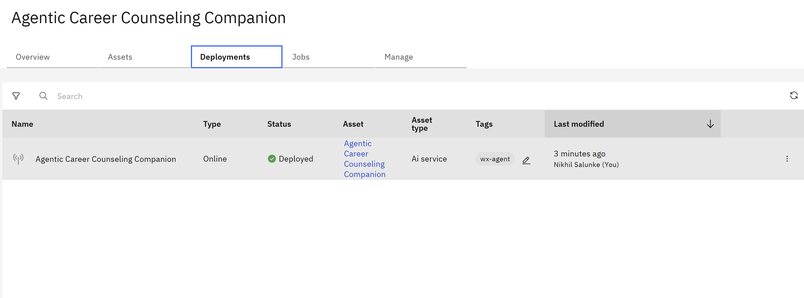
process

Slide 11
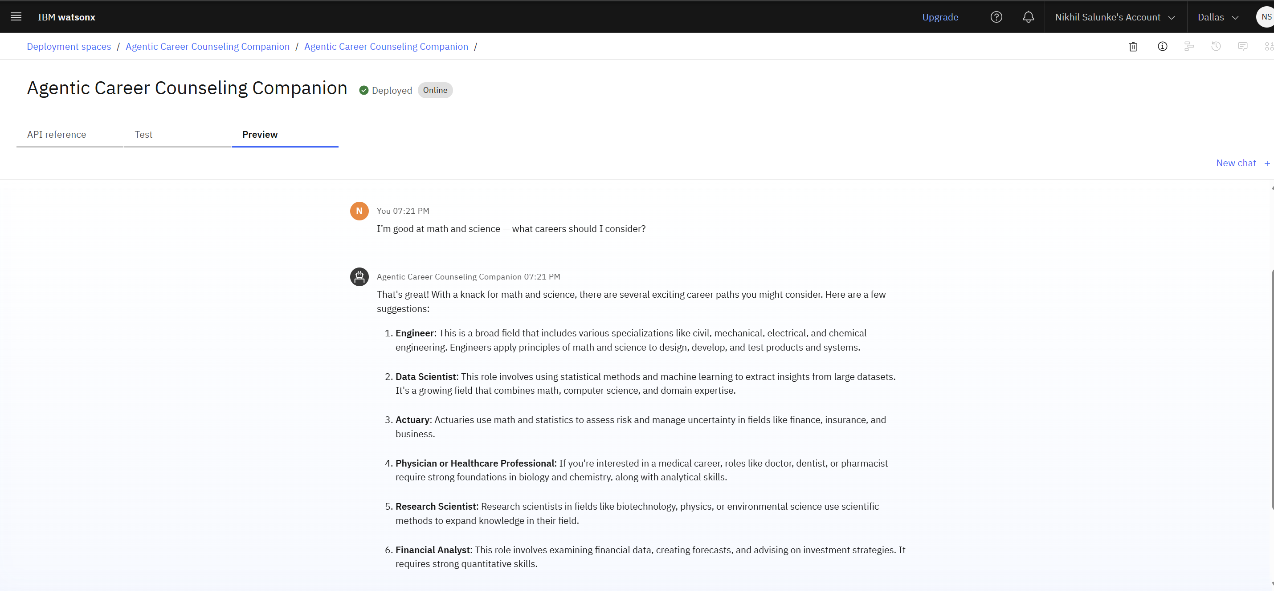
Results
Deployed AI Agent

Slide 12
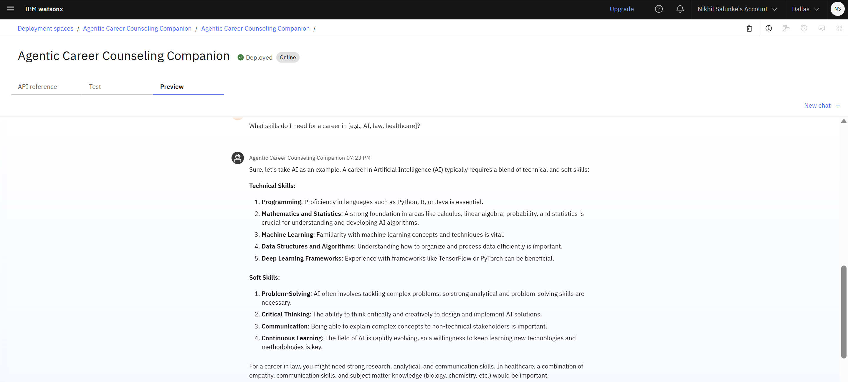

Slide 13
Conclusion
In conclusion, the Agentic Career Counseling Companion represents a transformative step toward democratizing access to personalized, data-driven career guidance.
By intelligently combining academic insights, evolving student interests, and real-time labor market trends, the agent empowers users to make confident, informed decisions about their futures.
Its autonomous, scalable, and always-available design makes it a powerful tool not only for students but also for educators, institutions, and workforce development programs.
This solution has the potential to bridge the gap between education and employment, fostering a generation of future-ready individuals equipped to thrive in a rapidly changing world.

Slide 14
Future scope
The future scope of the Agentic Career Counseling Companion is vast and impactful. In the coming years, the agent can evolve into a fully adaptive ecosystem that not only offers real-time guidance but also integrates seamlessly with learning management systems, academic records, and industry certifications.
With the incorporation of AI-driven emotional intelligence and behavioral analytics, the agent could better understand student motivation, stress levels, and engagement to provide even more empathetic support.
Future iterations may support multilingual interaction, regional career trends, and global job market insights—making the agent accessible and relevant to a diverse population.
Moreover, partnerships with educational institutions, online course providers, and employers could enable end-to-end career readiness pipelines, from education to employment.

Slide 15
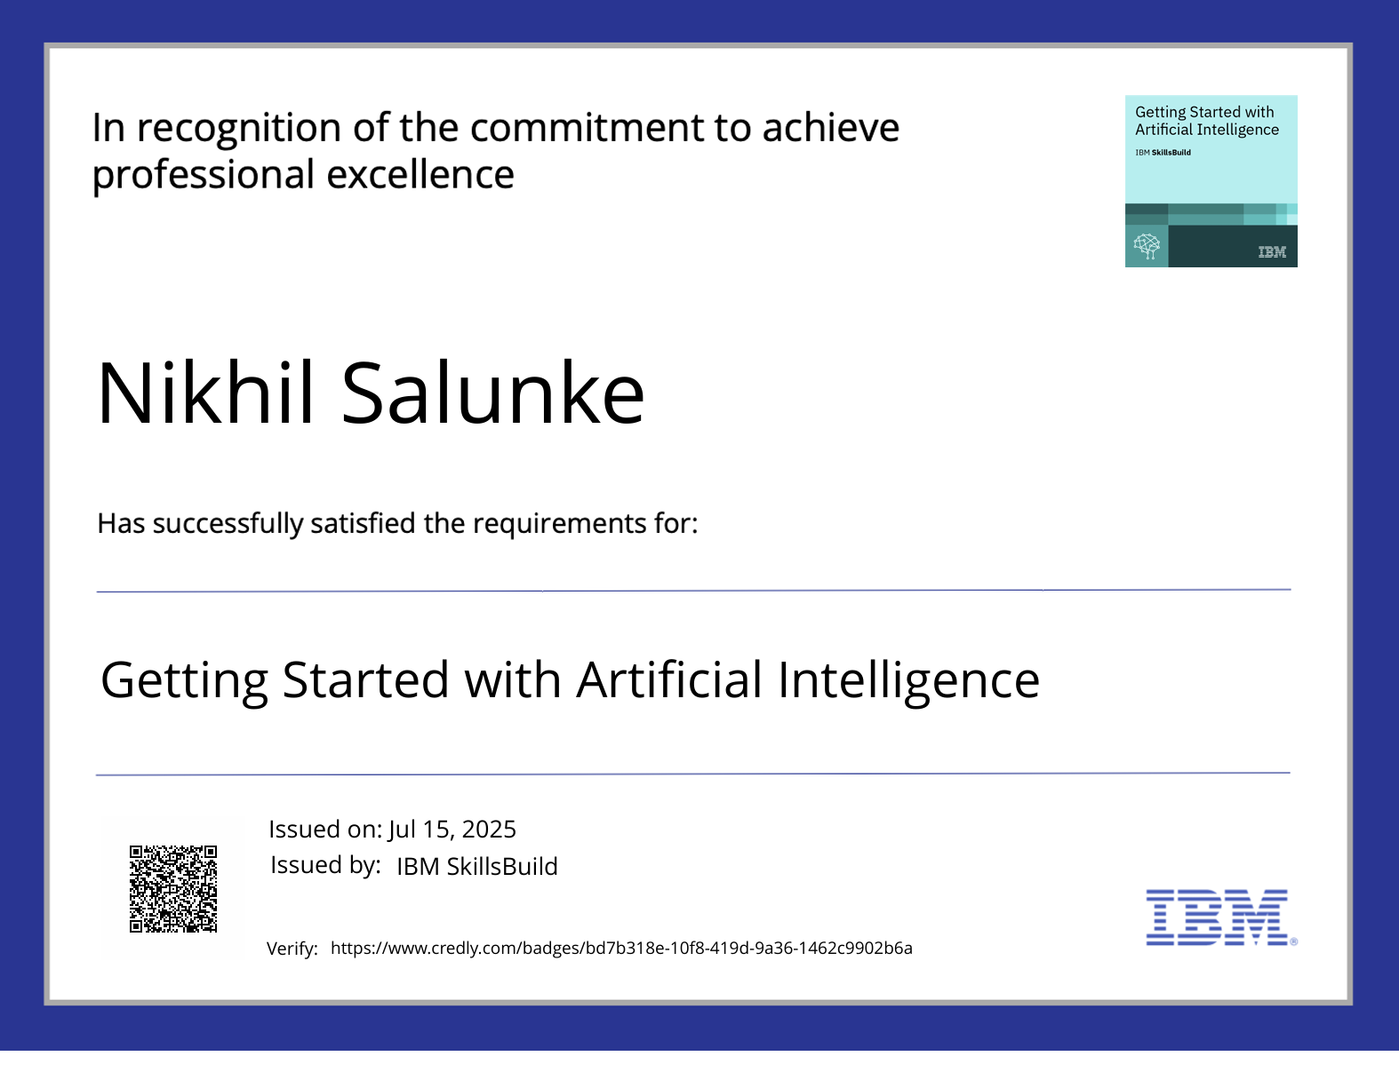
IBM Certifications

Slide 16
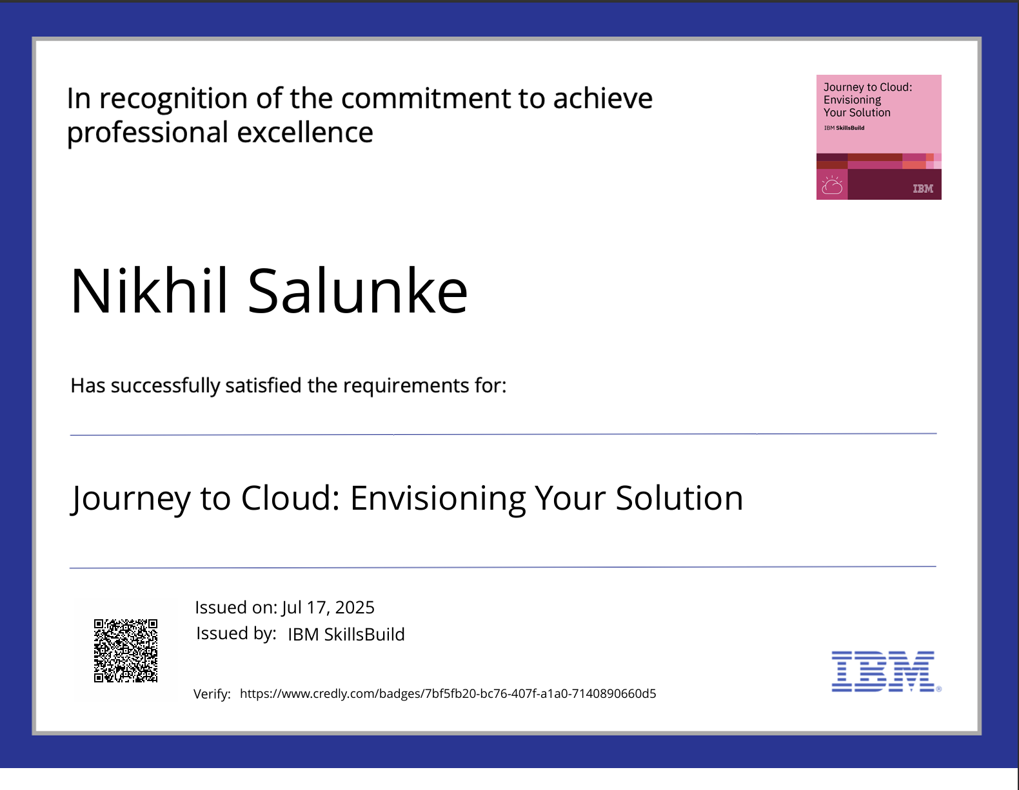
CERTIFICATIONS

Slide 17
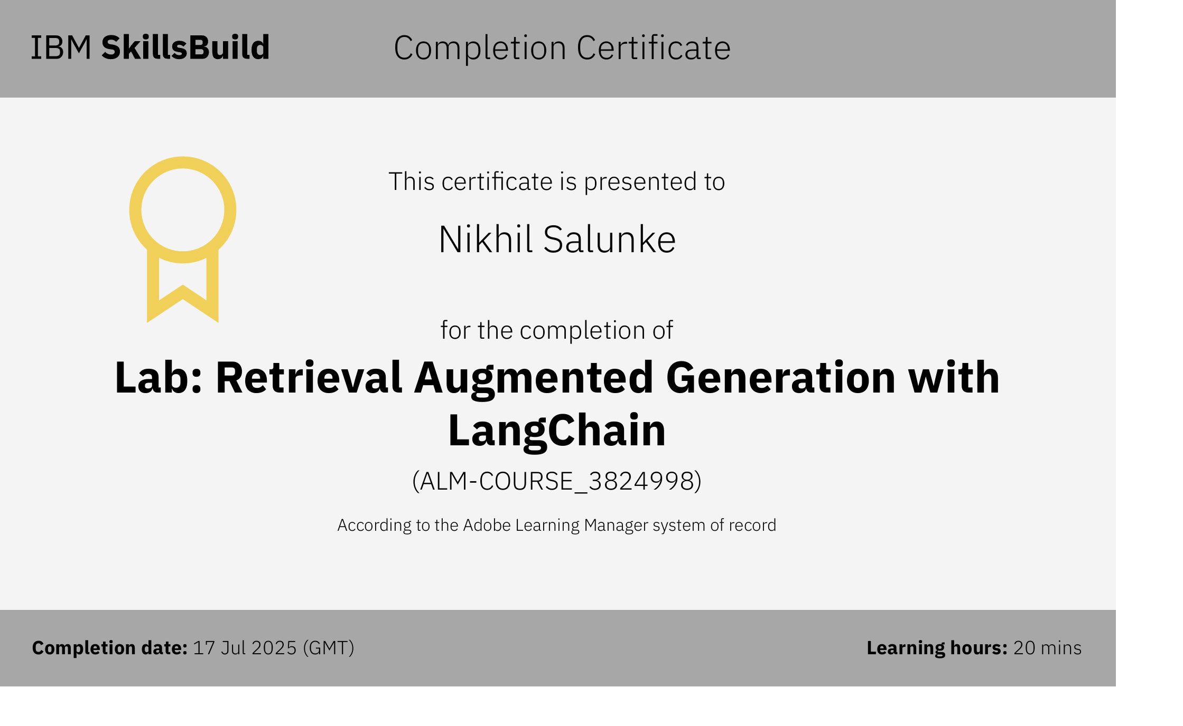
RAG LAB CERTIFICATE

Slide 18
GitHub Link
Git hub lik : Nikhil-salunke-eng/Agentic-Career-Counseling-Companion: Edunet Foundation IBM SkillsBuild

Slide 19
THANK YOU

